Slide 1
Employee Data Analysis using Excel
STUDENT NAME: MAAZEENA.A
REGISTER NO: 312212893 [asunm14512022g04]
DEPARTMENT: B.COM (GENERAL)
COLLEGE: MAHALASHMI WOMEN’S COLLEGE OF ARTS AND SCIENCE

Slide 2
PROJECT TITLE
Employee Performance Analysis using Excel

Slide 3


AGENDA
Problem Statement
Project Overview
End Users
Our Solution and Proposition
Dataset Description
Modelling Approach
Results and Discussion
Conclusion
3/21/2024 Annual Review

Slide 4

PROBLEM STATEMENT
Employee performance analysis is made to identify the performance level of an employee in each level helps to teach the activities and growth of the employees in wholly by department wise helps to grant remuneration or appreciation for the respected one.
Key points to address:
Department Performance Distribution: Determine how performance levels are distributed within each department and overall.
Department Comparisons: Compare performance levels between different departments to identify any significant disparities.
Performance Insights: Assess which departments have high numbers of high or very high performers and which have higher concentrations of low performers.

Slide 5

PROJECT OVERVIEW
1. Consolidate and standardize employee performance data
2. Apply conditional formatting, pivot tables, and pivot charts for intuitive analysis and visualization
3. Enable data-driven decision-making for talent development, growth, and performance improvement
4. Standardize performance evaluations and Identify development need
5. Inform data-driven decisions

Slide 6

WHO ARE THE END USERS?
The end users are likely to be: 1. HR Professionals 2. Managers/Supervisors 3. Team Leads 4. Department Heads 5. Senior Leadership

Slide 7

OUR SOLUTION AND ITS VALUE PROPOSITION
Conditional formatting
Filtering
Formula usage
Pivot table
Graph for data visualization
Informed decisions
Targeted improvements
Efficiency gains.

Slide 8
Dataset Description
This dataset contains employee performance data, including demographic information, performance evaluations, and job-specific metrics.
Data Points:
Employee ID (unique identifier)
Name
Department
Job Title
Performance Evaluation Rating (e.g., 1-5 scale)
Evaluation Period (date)
Job-Specific Metrics (e.g., salary, performance)
Data Source:
HR Information Systems, Performance Management Software, Employee Surveys.

Slide 9

THE "WOW" IN OUR SOLUTION
The WOW! In our solution is use of formula=IFS(Z8>=5,"VERY HIGH",Z8>=4,"HIGH",Z8>=3,"MED",TRUE,"LOW")
3/21/2024 Annual Review
9

Slide 10
MODELLING
Data Collection :
The data was downloaded from Edunet Dashboard.
Feature Collection :
Highlighted the features required from the given data.
Data Cleaning :
Identifying the blank missing data and filtering it by colour.
Performance level :
Performance level on basis of the department type.
Summary :
Pivot Table is created with row as Department type, column as performance level, filter as in gender, and count value as First name of the employees.
Data Visualization :
By using the graph chart to visualize the data shown in the Pivot Table
10

Slide 11
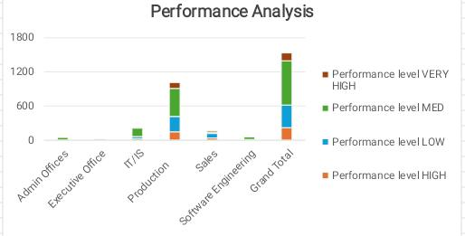
RESULTS
11

Slide 12
conclusion
In conclusion, the production department has performed well higher as when compared to other departments and the Admin Offices has performed the lowest.
According to the given data, the production department has the most efficient performance level in work than other department.
A breakdown of employee performance levels across various departments, categorized into High, Low, Medium, and Very High. It includes:
Departments: Admin Offices, Executive Office, IT/IS, Production, Sales, Software Engineering
Performance Levels: High, Low, Medium, Very High
Total Entries: 1,533 records
This data enables detailed analysis and comparison of performance metrics across different departments.

